Slide 1


Monika Nyakone Hegedus-Lukacs
20/06/2024

Slide 2

Outline
Executive Summary
Introduction
Methodology
Results
Conclusion
Appendix

Slide 3




Executive Summary
This project is about analyzing SpaceX launch records to gain valuable insights.
Our goal is to predict if the mission outcome will be successful or not.
Data has been collected from multiple sources and the datasets needed restructuring and data wrangling before the analysis could start.
Datasets have been analyzed by various means and methods such as Exploratory Data Analysis, Interactive Visual Analytics and Predictive Analysis.
The machine learning model built in this project can predict the mission outcome with an 83% accuracy.

Slide 4
Introduction
Project background
SpaceX is a private space company founded in 2002. It designs, manufactures and launches advanced rockets and spacecraft. It also manufactures a so-called Falcon 9 rocket whose first stage is capable of landing and reflight. Since the most expensive part of the rocket can be reused, the cost of space access can be significantly decreased.
Project goal
In this project, our goal is to predict if the first stage of Falcon 9 will land successfully or not. If we can predict the mission outcome, we can determine the cost of the mission more precisely, which might help when bidding against SpaceX as an alternate company.

Slide 5

Section 1

Slide 6





Methodology
Data Collection
Data Wrangling
Exploratory Data Analysis (EDA)
Interactive Visual Analytics
Predictive Analysis
Executive Summary
Data was collected from a REST API and via web scraping. During data wrangling, irrelevant data was removed, missing values were identified and replaced, string values were converted to numerical ones where needed. While performing Exploratory Data Analysis, various plots were generated and SQL was used to gain more insights. During Visual Analytics, an interactive Folium map and an interactive dashboard were created. Predictive Analysis was performed by building, tuning and evaluating various classification models.

Slide 7
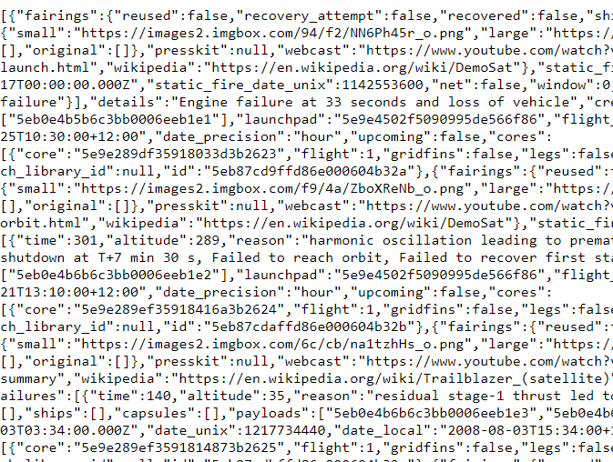
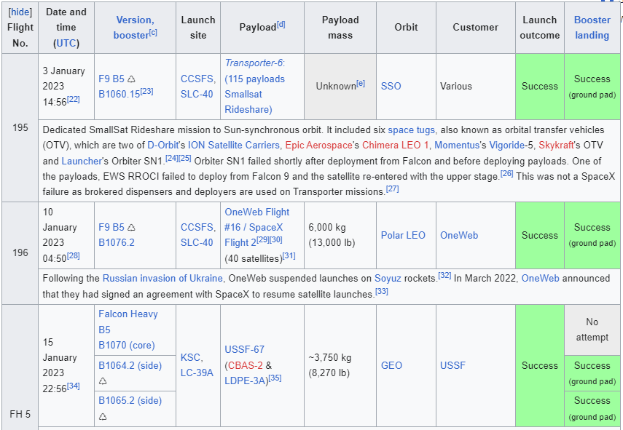
Data Collection
Data was collected from 2 sources:
SpaceX REST API:
https://api.spacexdata.com/v4/launches/past
2) Wikipedia – web scraping Falcon 9 launch records with BeautifulSoup

Slide 8
Data Collection – SpaceX API
Data collection with SpaceX REST calls
Sending HTTP GET request to SpaceX API and saving response
Decoding response as json and converting it to pandas dataframe
Extracting additional information from API based on IDs (cores, launchpads, …) into lists
Combining lists into dictionary and then converting it to a dataframe
spacex_url = https://api.spacexdata.com/v4/launches/past
response = requests.get(spacex_url)
data = pd.json_normalize(response.json())
getBoosterVersion(data)
getLaunchSite(data)
getPayloadData(data)
getCoreData(data)
launch_dict = {'FlightNumber': list(data['flight_number']),'Date': list(data['date']),'BoosterVersion':BoosterVersion,'PayloadMass':PayloadMass,'Orbit':Orbit,'LaunchSite':LaunchSite,'Outcome':Outcome,'Flights':Flights,'GridFins':GridFins,'Reused':Reused,'Legs':Legs,'LandingPad':LandingPad,'Block':Block,'ReusedCount':ReusedCount,'Serial':Serial,'Longitude': Longitude,'Latitude': Latitude}
launch_data = pd.DataFrame(launch_dict)
GitHub URL of SpaceX API calls:
Module-1_jupyter-labs-spacex-data-collection-api.ipynb

Slide 9
Data Collection – Web Scraping
Sending HTTP GET request to URL and saving response
Creating a BeautifulSoup object
Locating relevant data on webpage (i.e. 3rd table)
Extracting column names from header and parsing table for data
Creating a pandas dataframe from parsed data
Web scraping process
response = requests.get(static_url).text
soup = BeautifulSoup(response, 'html5lib')
html_tables = soup.find_all('table')
first_launch_table = html_tables[2] # 3rd table
column_names = []
launch_dict = dict.fromkeys(column_names)
# […] parsing table...
df = pd.DataFrame({ key:pd.Series(value) for key, value in launch_dict.items() })
GitHub URL of Web Scraping notebook:
Module-1_jupyter-labs-webscraping.ipynb

Slide 10
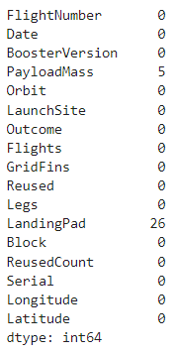
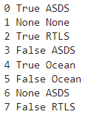
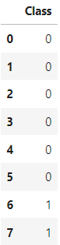
Data Wrangling
Removing irrelevant data (e.g. Falcon 1)
data_falcon9 = launch_data[launch_data['BoosterVersion']!='Falcon 1']
Identifying missing values
data_falcon9.isnull().sum()
Replacing missing values with mean value
avg_PayloadMass = data_falcon9['PayloadMass'].astype('float').mean(axis=0)
data_falcon9['PayloadMass'].replace(np.nan, avg_PayloadMass, inplace=True)
Converting landing outcomes to classes (1 or 0)
for i, outcome in enumerate(landing_outcomes.keys()):
print(i,outcome)
bad_outcomes = set(landing_outcomes.keys()[[1,3,5,6,7]])
landing_class = [0 if outcome in bad_outcomes else 1 for outcome in df['Outcome']]
df['Class'] = landing_class
GitHub URL of Data Wrangling related notebooks:
Module-1_jupyter-labs-spacex-data-collection-api.ipynb
Module-1_jupyter-labs-spacex-data-wrangling.ipynb

Slide 11
EDA with Data Visualization
The following charts have been plotted during EDA:
Task 1: Scatter plot displaying FlightNumber vs LaunchSite
Task 2: Scatter plot displaying PayloadMass vs LaunchSite
Task 3: Bar chart displaying Orbit vs mean success rate
Task 4: Scatter plot displaying Orbit vs FlightNumber
Task 5: Scatter plot displaying Orbit vs PayloadMass
Task 6: Line chart displaying Year vs mean success rate
GitHub URL of EDA with data visualization notebook:
Module-2_jupyter-labs-eda-dataviz.ipynb

Slide 12
EDA with SQL
The following SQL queries have been performed during EDA:
Task 1: %sql SELECT DISTINCT ("Launch_Site") FROM SPACEXTABLE;
Task 2: %sql SELECT * FROM SPACEXTABLE WHERE "Launch_Site" LIKE ('CCA%') LIMIT 5;
Task 3: %sql SELECT SUM(PAYLOAD_MASS__KG_) FROM SPACEXTABLE WHERE "Customer" = 'NASA (CRS)';
Task 4: %sql SELECT AVG(PAYLOAD_MASS__KG_) FROM SPACEXTABLE WHERE "Booster_Version" LIKE ('F9 v1.1%');
Task 5: %%sql SELECT MIN(DATE) FROM SPACEXTABLE
WHERE "Mission_Outcome" = 'Success' AND "Landing_Outcome" LIKE ('%ground%');
Task 6: %%sql SELECT "Booster_Version" FROM SPACEXTABLE
WHERE "Landing_Outcome" LIKE ('%Success%') AND "Landing_Outcome" LIKE ('%drone%')
AND PAYLOAD_MASS__KG_ BETWEEN 4000 AND 6000;
Task 7: %sql SELECT COUNT("Mission_Outcome") FROM SPACEXTABLE;
Task 8: %%sql SELECT "Booster_Version" FROM SPACEXTABLE
WHERE PAYLOAD_MASS__KG_ = (SELECT MAX(PAYLOAD_MASS__KG_) FROM SPACEXTABLE);
Task 9: %%sql SELECT substr(Date, 6,2) AS Month, "Landing_Outcome", "Booster_Version", "Launch_Site"
from SPACEXTABLE WHERE "Landing_Outcome" LIKE ('%Failure%') AND "Landing_Outcome" LIKE ('%drone%')
AND substr(Date,0,5)='2015';
Task 10: %%sql SELECT * FROM (SELECT "Landing_Outcome", COUNT(*) AS QTY FROM SPACEXTABLE
WHERE Date BETWEEN "2010-06-04" and "2017-03-20" GROUP BY "Landing_Outcome" ) AS TASK_10_TABLE;
GitHub URL of EDA with SQL notebook: Module-2_jupyter-labs-eda-sql.ipynb

Slide 13
Build an Interactive Map with Folium
The following map objects have been created and added:
Folium Map object (folium.Map) to create a map
Circle object (folium.Circle) to add a highlighted circle area for each launch site
Marker object (folium.map.Marker) to mark specific locations on the map
Polyline object (folium.PolyLine) to draw a line between two points
GitHub URL of Interactive Map with Folium:
Module-3_jupyter-labs-launch-sites.ipynb

Slide 14
Build a Dashboard with Plotly Dash
The following plots/graphs and interactions have been added to the dashboard:
Dropdown menu (dcc.Dropdown) to enable users to select launch sites
Pie chart (px.pie) to visualize success rate per launch site
Range slider (dcc.RangeSlider) to enable users to select a payload range
Scatter plot (px.scatter) to visualize how payload and mission outcomes are correlated
GitHub URL of Plotly Dash app:
Module-3_spacex_dash_app.py

Slide 15
Predictive Analysis (Classification)
Model development process:
GitHub URL of Predictive Analysis lab:
Module-4_jupyter-labs-machine-learning.ipynb
Creating a numpy array from column Class
Splitting the data into training and test data
Standardizing the data in dataframe X
Creating a classification model object
Fitting the object to find the best parameters
Calculating the accuracy of the classification model

Slide 16
Results
Exploratory data analysis results are introduced in
Section 2: Insights drawn from EDA
Interactive analytics demo in screenshots is presented in
Section 3: Launch Sites Proximities Analysis
Section 4: Build a Dashboard with Plotly Dash
Predictive analysis results are introduced in
Section 5: Predictive Analysis (Classification)

Slide 17

Section 2

Slide 18
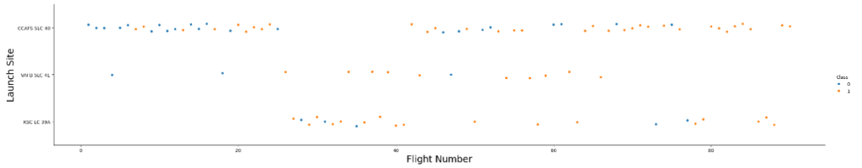
Flight Number vs. Launch Site
sns.catplot(y="LaunchSite", x="FlightNumber", hue="Class", data=df, aspect = 5)
plt.xlabel("Flight Number",fontsize=20)
plt.ylabel("Launch Site",fontsize=20)
plt.show()
Scatter plot of Flight Number vs. Launch Site
Explanations:
The most flights are launched from the site called CCAFS SLC 40.
The launch sites VAFB SLC 4E and KSC LC 39A have got a similar success rate.

Slide 19
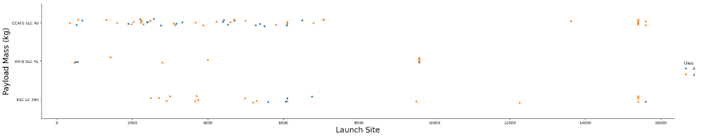
Payload vs. Launch Site
sns.catplot(x="PayloadMass", y="LaunchSite", hue="Class", data=df, aspect = 5)
plt.xlabel("Launch Site",fontsize=20)
plt.ylabel("Payload Mass (kg)",fontsize=20)
plt.show()
Scatter plot of Payload vs. Launch Site
Explanations:
Rockets with heavy payload are launched both from CCAFS SLC 40 and KSC LC 39A but not from VAFB SLC 4E.

Slide 20
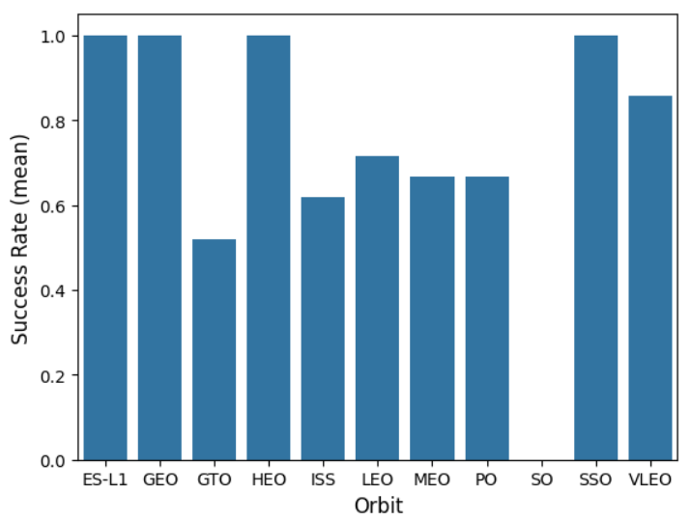
Success Rate vs. Orbit Type
df_task3 = df.groupby(['Orbit']).mean('Class')
sns.barplot(x='Orbit', y='Class', data=df_task3)
plt.xlabel("Orbit", fontsize=12)
plt.ylabel("Success Rate (mean)", fontsize=12)
plt.show()
Bar chart displaying the success rate of each orbit type
Explanations:
The orbits ES-L1, GEO, HEO and SSO have got the highest success rate.
The worst success rate belongs to the orbit GTO.

Slide 21
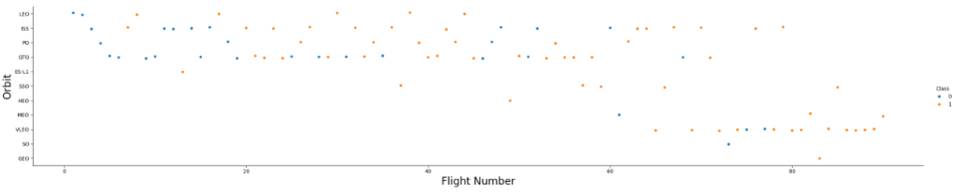
Flight Number vs. Orbit Type
sns.catplot(y="Orbit", x="FlightNumber", hue="Class", data=df, aspect = 5)
plt.xlabel("Flight Number",fontsize=20)
plt.ylabel("Orbit",fontsize=20)
plt.show()
Scatter plot of Flight number vs. Orbit type
Explanations:
The success rate seems to be correlated to the number of flights on the orbit LEO.
No such relationship is observed on the other orbits.

Slide 22
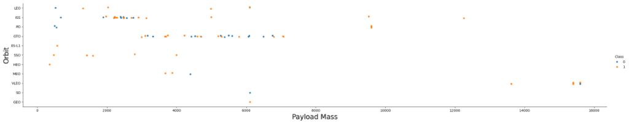
Payload vs. Orbit Type
sns.catplot(y="Orbit", x="PayloadMass", hue="Class", data=df, aspect = 5)
plt.xlabel("Payload Mass",fontsize=20)
plt.ylabel("Orbit",fontsize=20)
plt.show()
Scatter plot of Payload vs. Orbit type
Explanations:
Rockets with the heaviest payload are on the orbit VLEO.
The success rate and the payload seems to be positively correlated on the orbits LEO, ISS and PO.

Slide 23
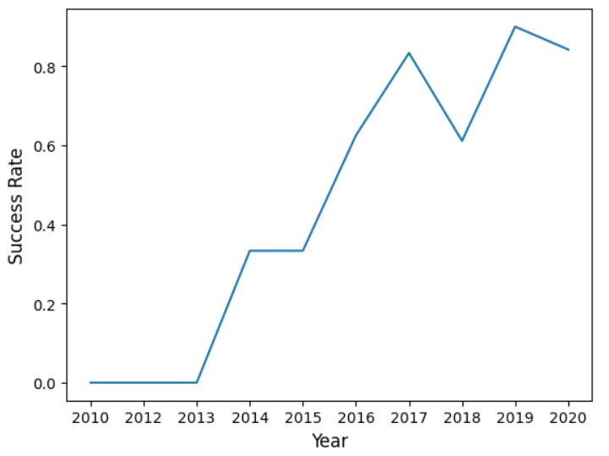
Launch Success Yearly Trend
sns.lineplot(x=np.unique(df['Date']), y=df.groupby('Date')['Class'].mean())
plt.xlabel("Year",fontsize=12)
plt.ylabel("Success Rate",fontsize=12)
plt.show()
Line chart displaying yearly average success rate
Explanations:
The success rate and year are positively correlated.

Slide 24
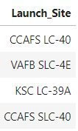
All Launch Site Names
Finding the names of the unique launch sites:
%sql SELECT DISTINCT ("Launch_Site") FROM SPACEXTABLE;
Explanation:
There are 4 unique launch sites in the dataset.

Slide 25
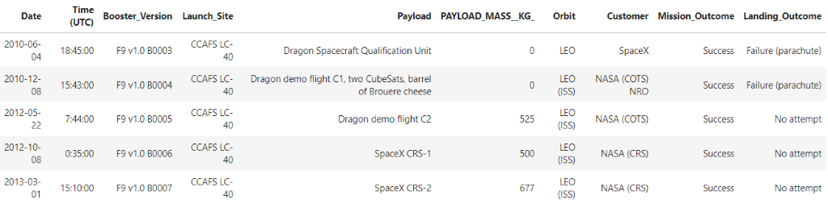
Launch Site Names Begin with 'CCA'
Finding 5 records where launch sites begin with `CCA`:
%%sql SELECT * FROM SPACEXTABLE
WHERE "Launch_Site" LIKE ('CCA%') LIMIT 5;
Explanation:
Records have been filtered to contain only the rows where launch sites begin with "CCA", from which only 5 records are displayed.

Slide 26
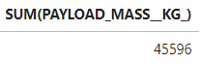
Total Payload Mass
Calculating the total payload carried by boosters from NASA:
%%sql
SELECT SUM(PAYLOAD_MASS__KG_) FROM SPACEXTABLE
WHERE "Customer" = 'NASA (CRS)';
Explanation:
The sum of all values in Payload_Mass is displayed as a result.

Slide 27
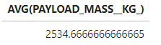
Average Payload Mass by F9 v1.1
Calculating the average payload mass carried by booster version F9 v1.1:
%%sql
SELECT AVG(PAYLOAD_MASS__KG_) FROM SPACEXTABLE
WHERE "Booster_Version" LIKE ('F9 v1.1%');
Explanation:
Records have been filtered to contain only the rows where the Booster Version is F9 v1.1 and the average of the values is displayed as a result.

Slide 28
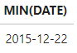
First Successful Ground Landing Date
Finding the dates of the first successful landing outcome on ground pad:
%%sql
SELECT MIN(DATE) FROM SPACEXTABLE
WHERE "Mission_Outcome" = 'Success'
AND "Landing_Outcome" LIKE ('%ground%');
Explanations:
Records have been filtered to contain only the rows where the mission was successful and the rocket has landed on a ground pad. The first date is displayed as a result.

Slide 29
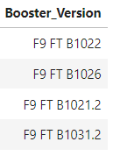
Successful Drone Ship Landing with Payload between 4000 and 6000
Listing the names of boosters which have successfully landed on drone ship and had payload mass greater than 4000 but less than 6000:
%%sql
SELECT "Booster_Version" FROM SPACEXTABLE
WHERE "Landing_Outcome" LIKE ('%Success%')
AND "Landing_Outcome" LIKE ('%drone%')
AND PAYLOAD_MASS__KG_ BETWEEN 4000 AND 6000;
Explanation:
Records have been filtered to contain only the rows where:
the mission was successful,
and the rocket has landed on a drone ship,
and the payload mass is between 4000 and 6000 kg.
The booster versions are displayed as a result.

Slide 30
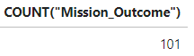
Total Number of Successful and Failure Mission Outcomes
Calculating the total number of successful and failure mission outcomes:
%sql SELECT COUNT("Mission_Outcome") FROM SPACEXTABLE;
Explanation:
The values in Mission_Outcome have been counted and this number is displayed as a result.

Slide 31
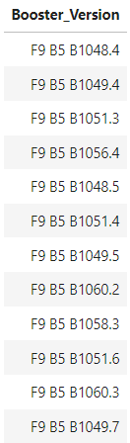
Boosters Carried Maximum Payload
Listing the names of the booster which have carried the maximum payload mass:
%%sql
SELECT "Booster_Version" FROM SPACEXTABLE
WHERE PAYLOAD_MASS__KG_ = (SELECT MAX(PAYLOAD_MASS__KG_) FROM SPACEXTABLE);
Explanation:
Records have been filtered to contain only the rows where the rockets have carried the heaviest payload mass.
The booster versions are displayed as a result.

Slide 32
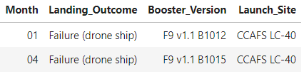
2015 Launch Records
List the failed landing_outcomes in drone ship, their booster versions, and launch site names for in year 2015
%%sql
SELECT substr(Date, 6,2) AS Month, "Landing_Outcome", "Booster_Version", "Launch_Site" from SPACEXTABLE
WHERE "Landing_Outcome" LIKE ('%Failure%')
AND "Landing_Outcome" LIKE ('%drone%')
AND substr(Date,0,5)='2015';
Explanation:
Records have been filtered to contain only the rows where the landing outcome on a drone ship was a failure in 2015.

Slide 33
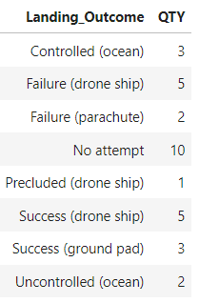
Rank Landing Outcomes Between 2010-06-04 and 2017-03-20
Ranking the count of landing outcomes (such as Failure (drone ship) or Success (ground pad)) between the date 2010-06-04 and 2017-03-20, in descending order:
%%sql
SELECT * FROM (
SELECT "Landing_Outcome", COUNT(*) AS QTY FROM SPACEXTABLE
WHERE Date BETWEEN "2010-06-04" and "2017-03-20"
GROUP BY "Landing_Outcome"
) AS TASK_10_TABLE;
Explanation:
Records have been filtered to contain only the rows between the dates 2010-06-04 and 2017-03-20, and the numbers of different landing outcomes are displayed.

Slide 34

Section 3

Slide 35
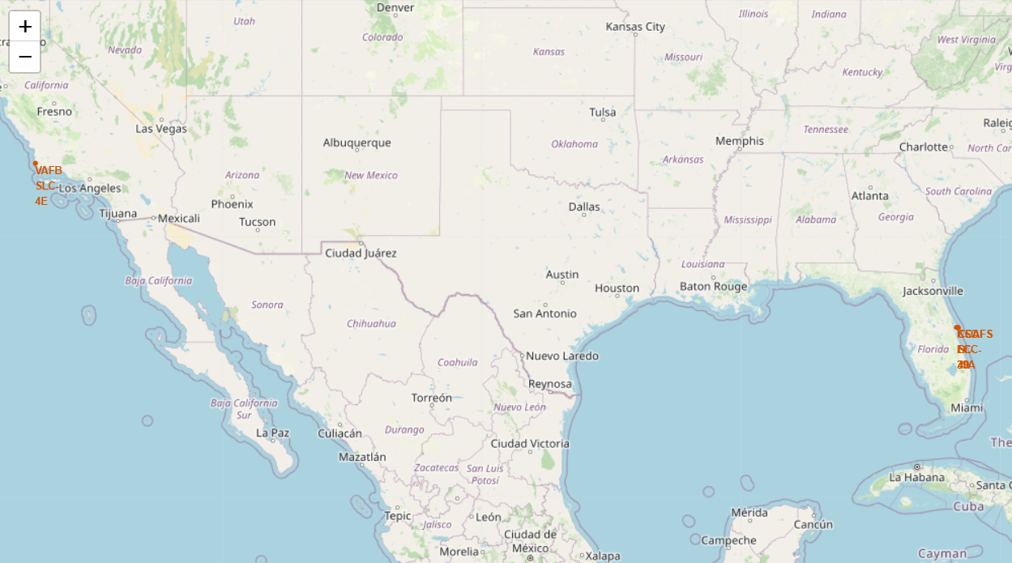
Marking All Launch Sites on a Folium Map
SpaceX launch sites are:
close to the equator
close to the ocean
close to transportation infrastructure

Slide 36
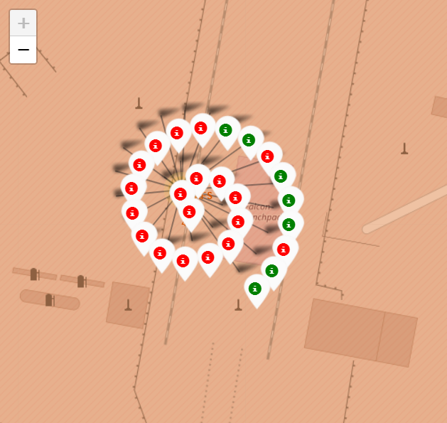
Marking Successful/Failed Launches on Each Site
By adding colour-labelled markers to the site map, the launch outcomes become clearly visible on each site.
For example:
most of the missions on the launch site CCAFS LC-40 ended with a failure,
whereas, most of the missions on the launch site KSC LC-39A were successful.

Slide 37
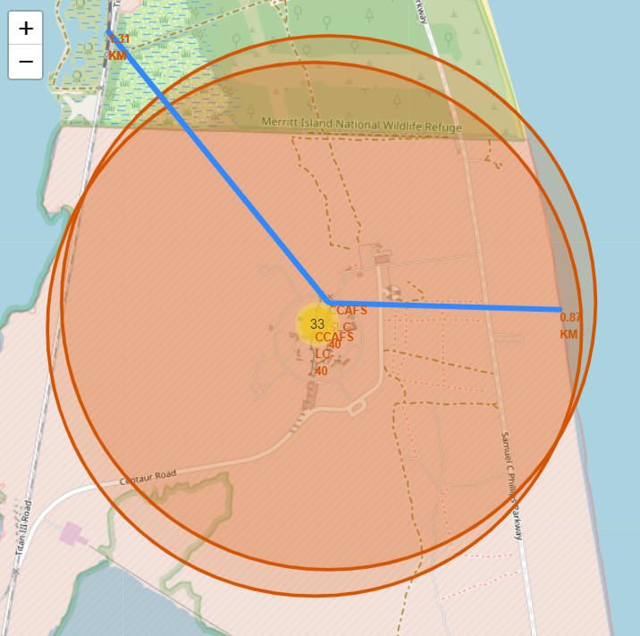
Calculating Distances between a Launch Site and its Proximities
By adding distance markers to the site map, the distance of launch sites from their proximities become clearly visible.
For example, the launch site CCAFS SLC-40 is
0.87 km from the coastline
1.31 km from the NASA Railroad

Slide 38

Section 4

Slide 39
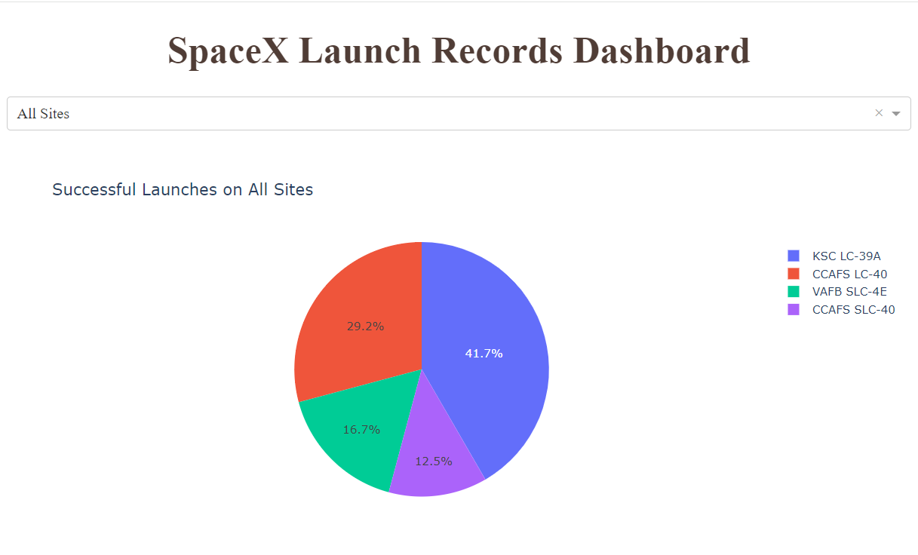
Successful Launches on All Sites
The most successful launches have been performed on the launch site called
Kennedy Space Center's Launchpad 39A.

Slide 40
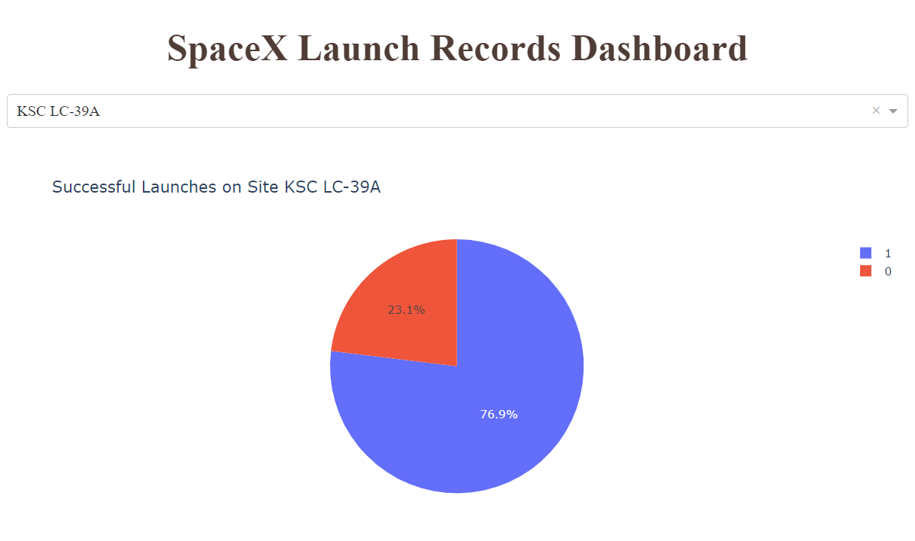
Successful Launches on Site KSC LC-39A
The launch site KSC LC-39A has got the highest launch success ratio:
only 23.1% of launches failed
whereas 76.9% of launches was successful

Slide 41
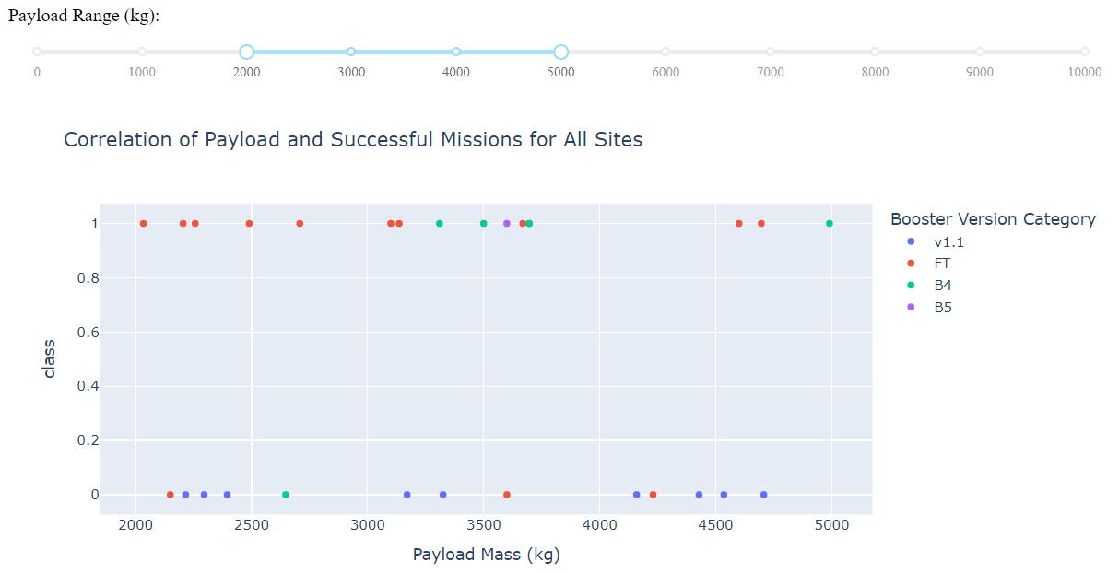
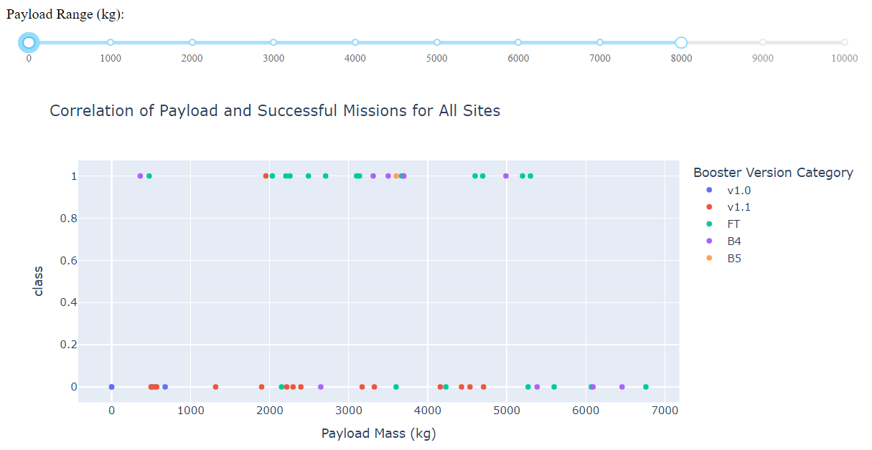
Payload vs Launch Outcome on All Sites
The scatter plot displaying the Payload vs. Launch Outcome on all sites shows:
the booster version FT has got the highest success rate
the highest ratio of successful outcomes is between the payload range of 2000 and 5000 kg.

Slide 42

Section 5

Slide 43
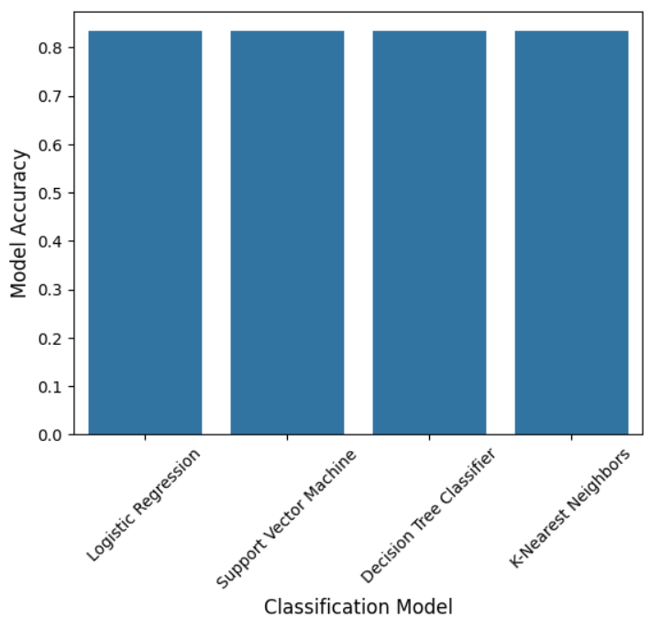
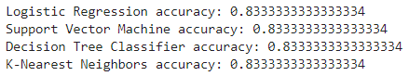
Classification Accuracy
The classification models built in this lab have got the same accuracy:

Slide 44
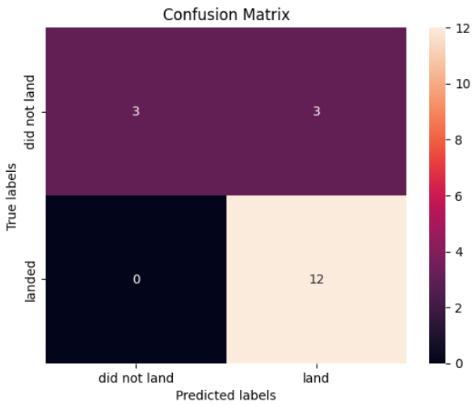
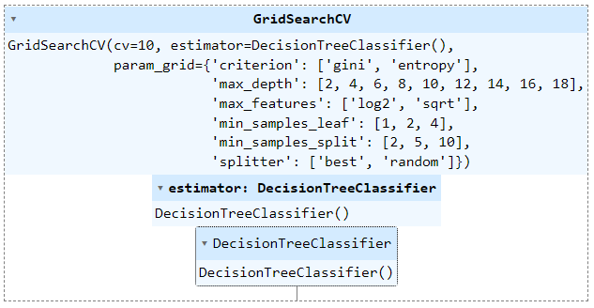
Confusion Matrix
The confusion matrix of the DecisionTreeClassifier model shows that
it predicts well the positive outcomes,
however, the number of false positives is relatively high

Slide 45
Conclusions
Success rate and time are positively correlated.
The highest success rate belongs to
the launch site KSC LC-39A with a success ratio of 76.9%
the orbits ES-L1, GEO, HEO and SSO
the booster version FT
the payload range between 2000 and 5000 kg.
The average payload mass carried by boosters is 6138 kg.
Rockets with heavy payload are launched both from CCAFS SLC 40 and KSC LC 39A but not from VAFB SLC 4E.
The classification models built in this lab can predict the mission outcome with an 83% accuracy.

Slide 46
Appendix
Datasets:
Spacex.xlsx
spacex_web_scraped.csv
dataset_part_1.csv
dataset_part_2.csv
dataset_part_3.csv
spacex_launch_dash.xlsx

Slide 47


